Slide 1




LA Crime Data Analysis
Rohini Patturaja (700763677)

Slide 2

01 - Key Objectives
02 - Data Introduction
03 - Data Cleaning & Pre-Processing
04 - Key Insights & Strategic Recommendations

Slide 3

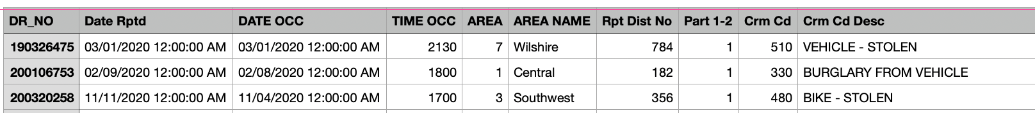
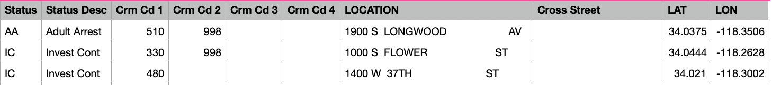

Data Introduction
2020 to Present
Reporting district number where the crime was reported
Crime classification (serious/non-serious)
Unique crime report ID
Date and time crime was reported, occured
Unique code for the crime type
Modus Operandi code
The age, gender and ethnicity of the victim
A code for where the crime occured (e.g residential, business)
Additional crime category codes
Location data of crime occured
Nearest cross street to the crime location
Rows = 1005199
Columns = 28

Slide 4
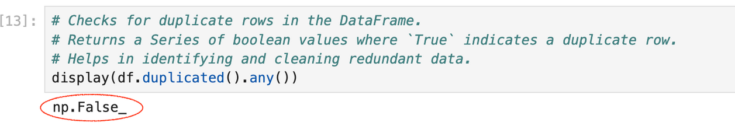
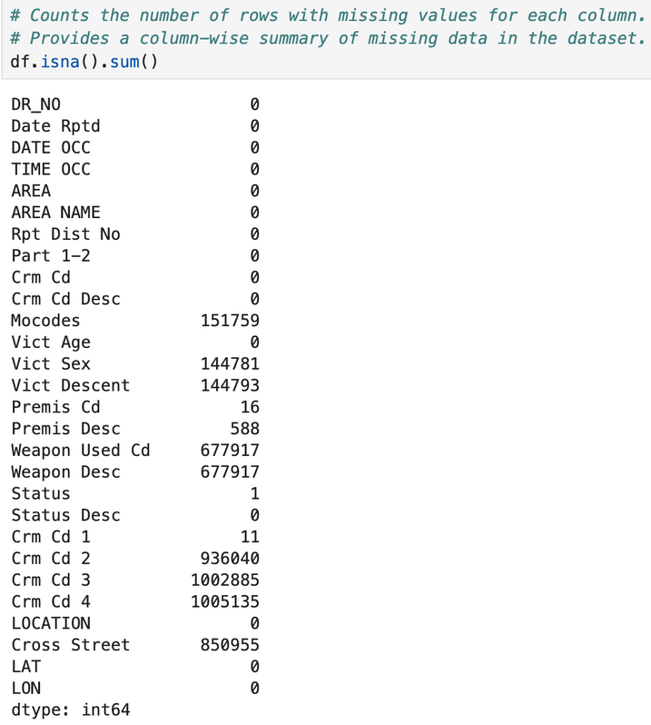
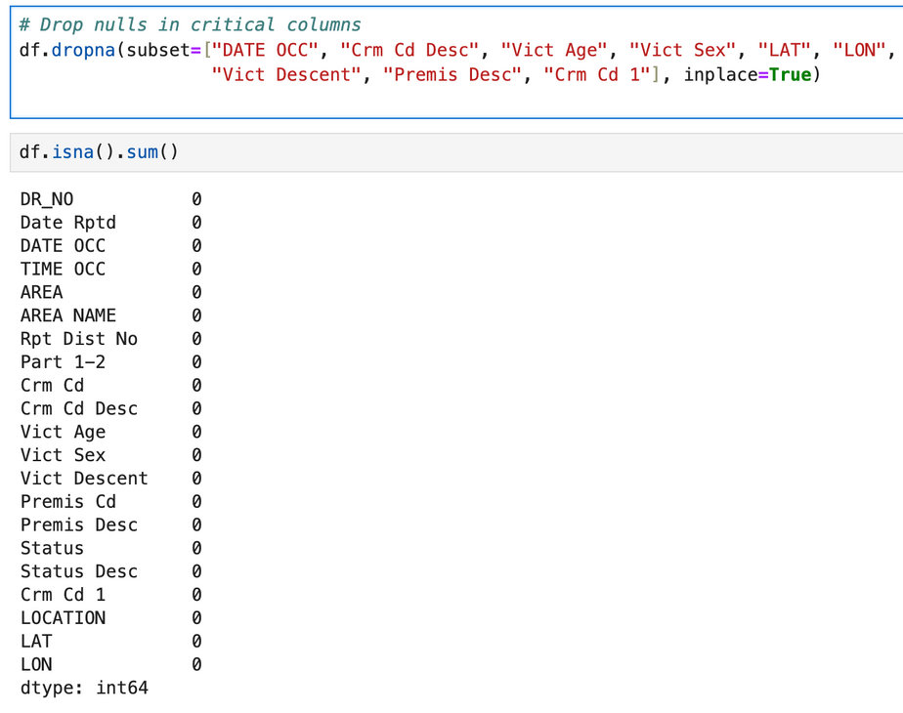
Data Cleaning & Pre-Processing
* Duplicate check
* Handling Missing Values
The dataset doesn’t have any duplicates and dropped the unnecessary columns and null records

Slide 5

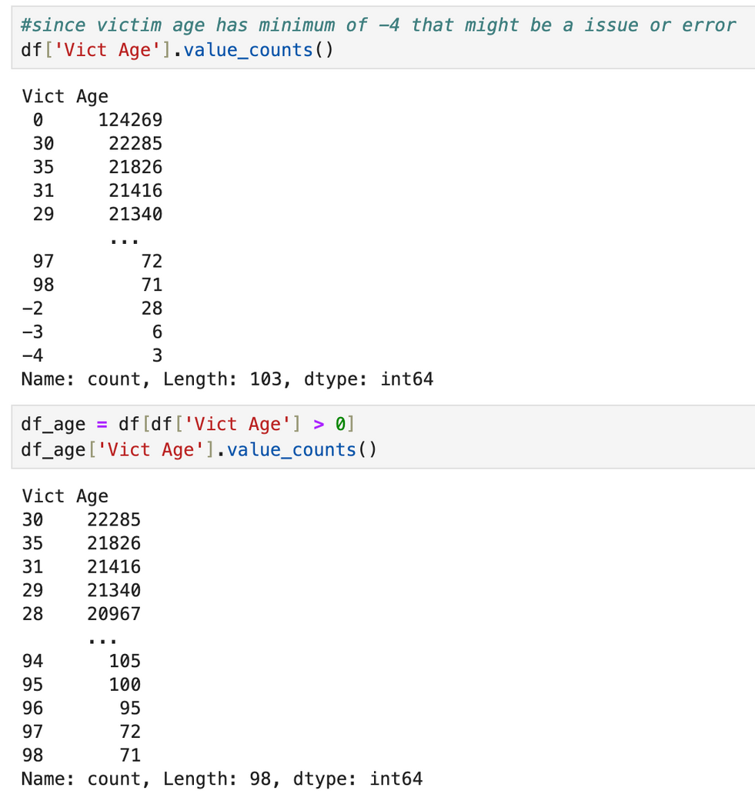
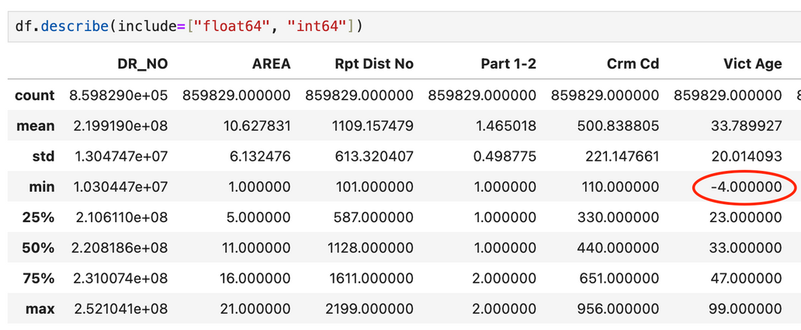
Correct Outliers or Invalid Data
The 'Vict Age' column contains invalid negative values (e.g., -4), which can cause errors in analysis. To ensure data integrity, records with non-positive ages are excluded using the filter

Slide 6
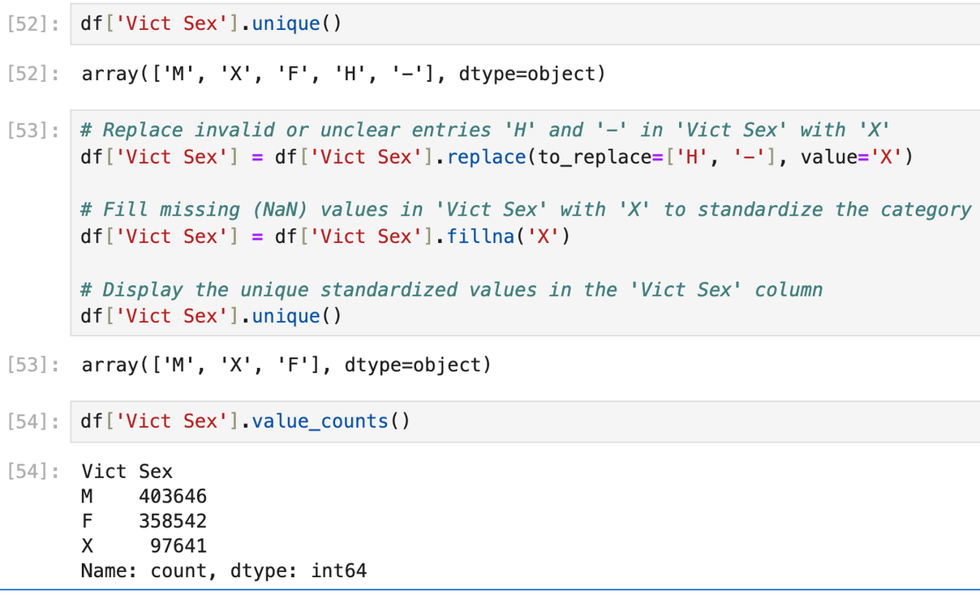
The Latitude and Longitude values had “-1” or “0” as placeholder data for missing one. I removed such rows from the data for generating some geolocation-related insights and heatmaps. Rows lost =~2.1k
Normalize Columns.
Replaced invalid entries ('H' and '-') in the 'Vict Sex' column with 'X' and filled missing (NaN) values with 'X' to standardize the data.

Slide 7
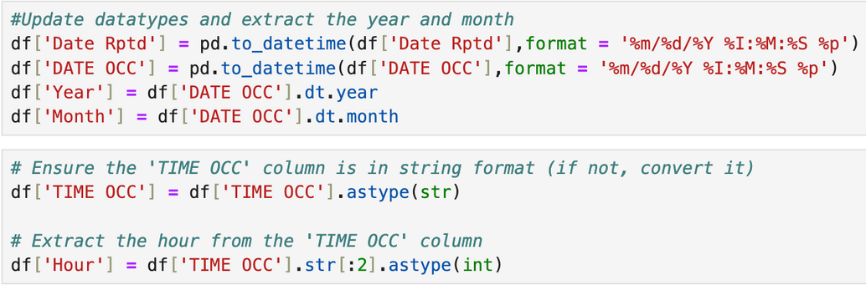


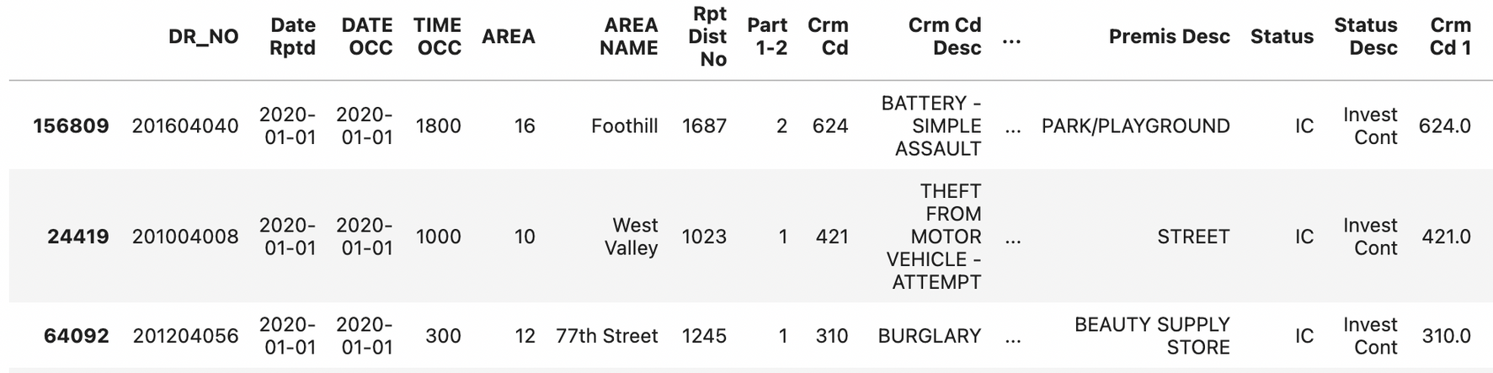
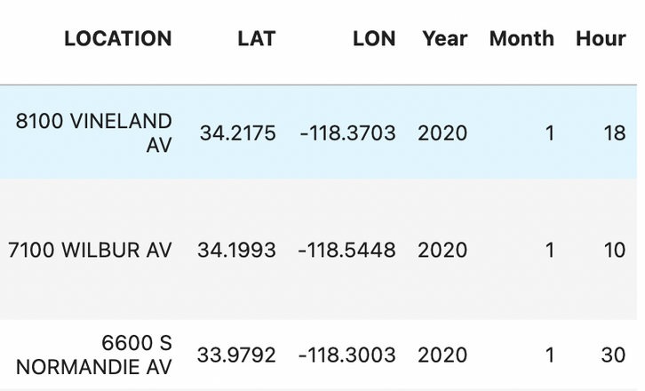
Fix Incorrect Data types
Extract Columns
Feature Engineering
Date ,Time and Hour were in the same column in the dataset. To make processing easier, I separated those three out.

Slide 8
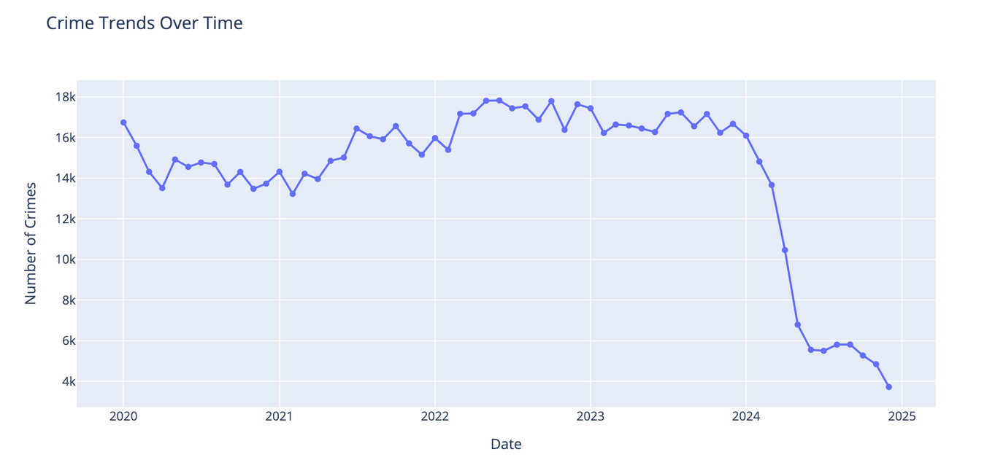
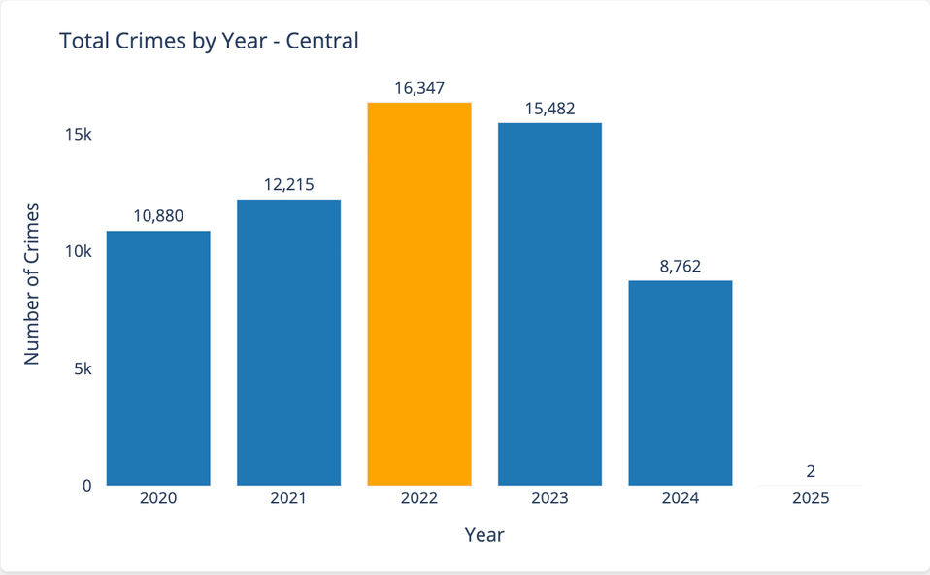
Temporal Analysis
What are the overall crime trends from 2020 to 2024?
Steady to rising crime rates until 2022, crime peaked in 2022 at Central LA could be related to post-COVID urban activity resumption. 2024 saw a dramatic drop, a 43.4% decrease from 2023. We don’t see any data in 2025 because the data is incomplete.

Slide 9

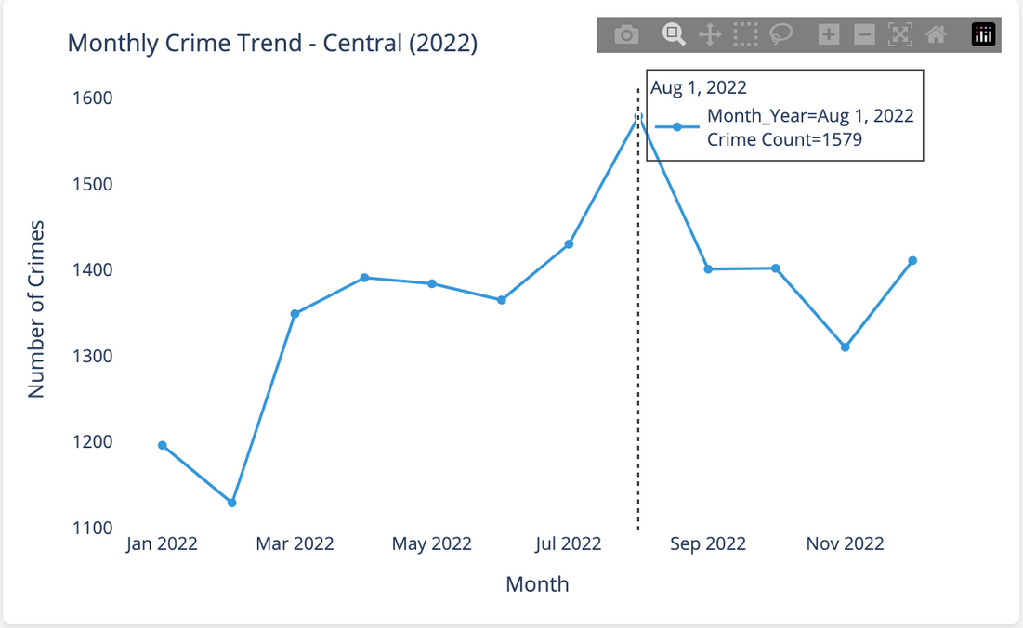
What months experienced the highest and lowest crime rates in 2022?
Central LA needs continued attention — although crime dropped post-August 2022, it's still relatively high. Crime gradually increased from spring to summer, peaking in midsummer. A decline in winter shows reduced crime activity.

Slide 10
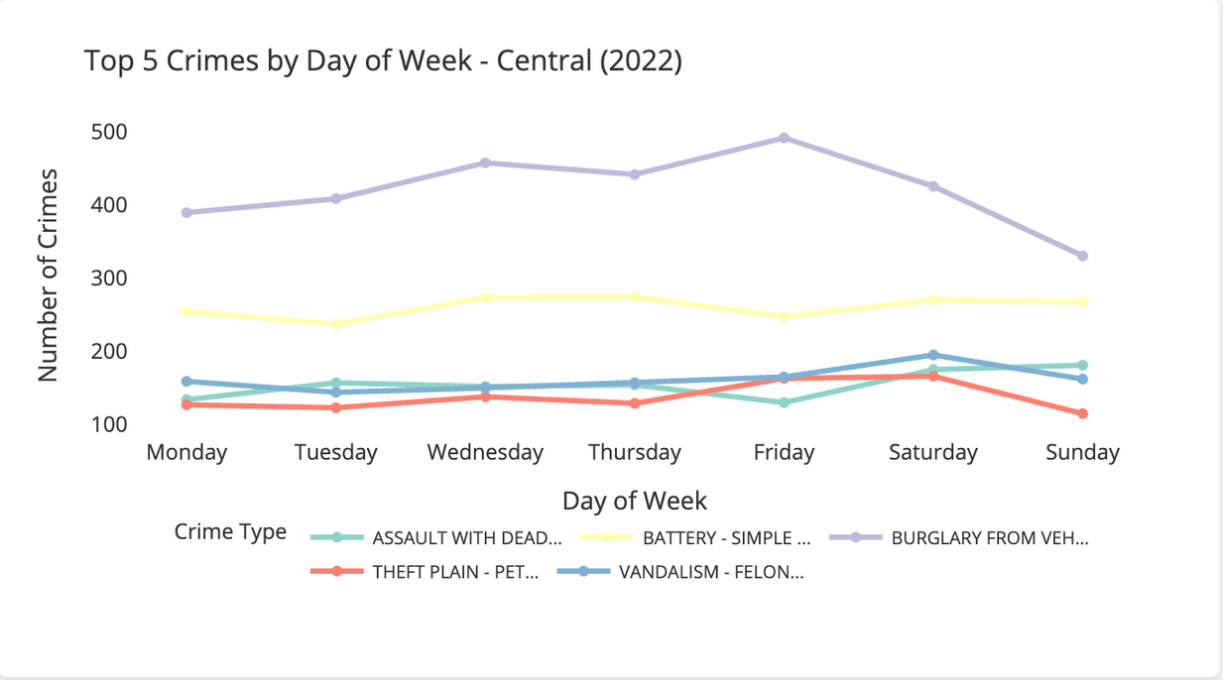
Are weekends or weekdays riskier in terms of criminal activity?
Friday is the riskiest day, with spikes especially burglary from vehicles.Simple assault and Vandalism also peak on Saturday, showing links to social interaction and alcohol-related behaviour. Sunday drop in petty thefy may indicate fewer commercial or store closures.

Slide 11
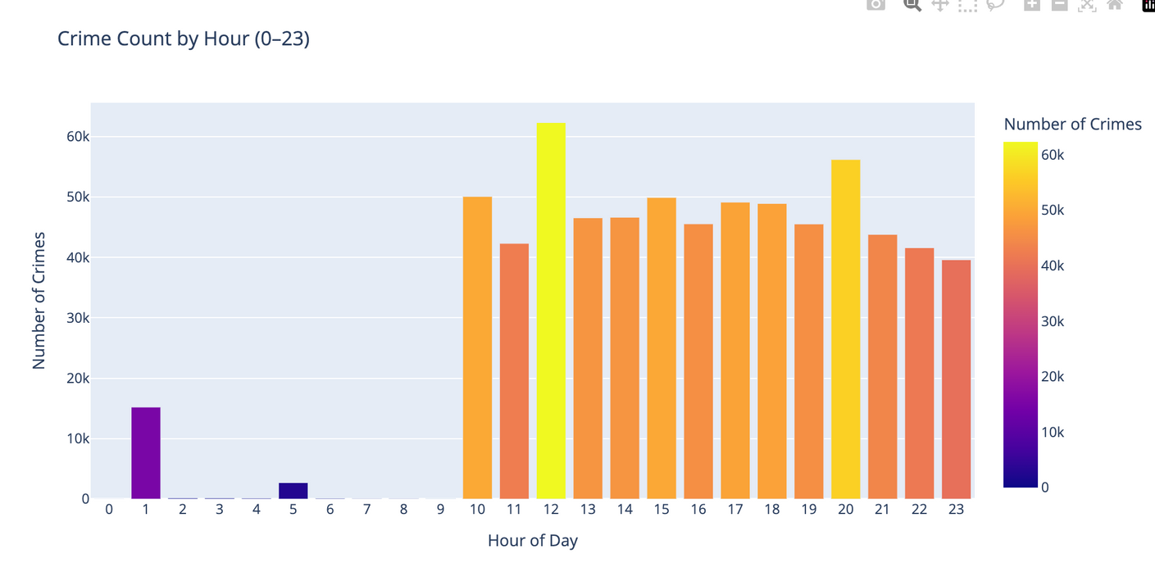
Do peak crime hours correspond to public activity patterns (e.g. work, nightlife)?
Most crimes in LA erupt during daylight and early evening hours — not in the dead of night. Surprisingly, noon is LA’s most dangerous hour, not midnight. This suggests crimes are more likely to happen during regular routines like commuting, shopping, or lunch breaks — when people are most active and visible.

Slide 12
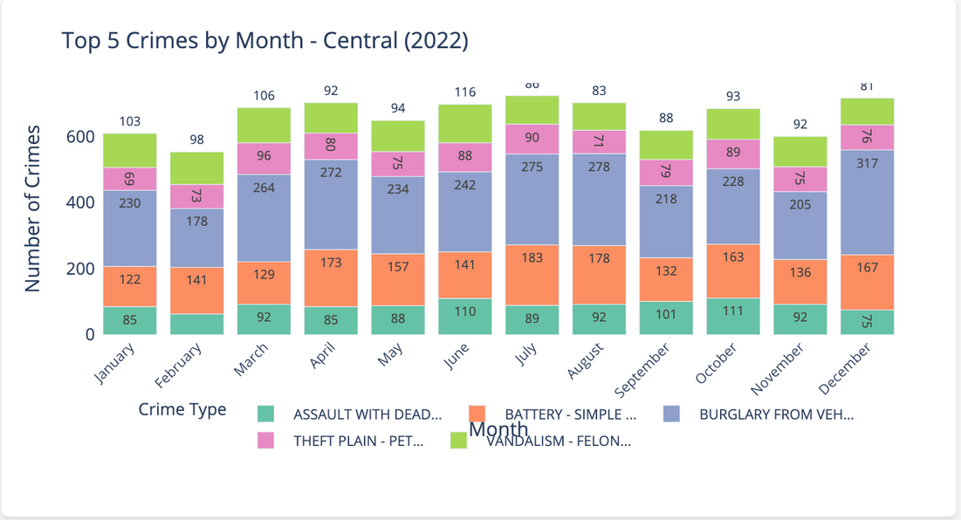
Descriptive Statistical Analysis
Are there seasonal or monthly peaks in specific crime types?
Burglary from vehicle - Higgest reported crime every month especially December spike , it may leads due to holiday shopping season. June to August shows elevated vandalism and battery incidents may due to public activity, travel in summer. Assault with Deadly weapon peaks in June and October.

Slide 13
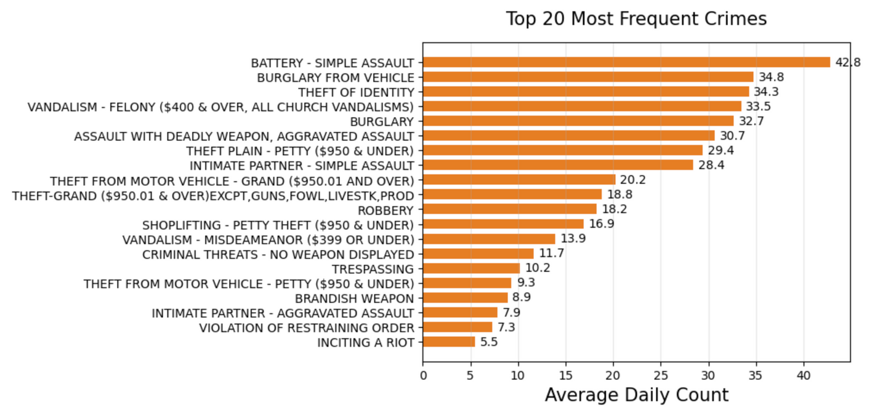
Which crimes are surging and need priority attention?
Burglary from vehicle, Theft from motor vehicle,Petty motor vehicle thefy together they total over 64 daily incidents, showing cars are a major target for theft. Identity thefy is a top 3 crime may relate to increased online fraud,phishing or data breaches.Vandalism and Burglary combined over 80 daily incidents, a clear indicator of propery crime pressures.Domestic violence appears twice, indicating rising intimate partner assault trends. LA Police department should prioritize policing in high-theft zones.Should promote community awareness campaigns, install smart sensors.

Slide 14
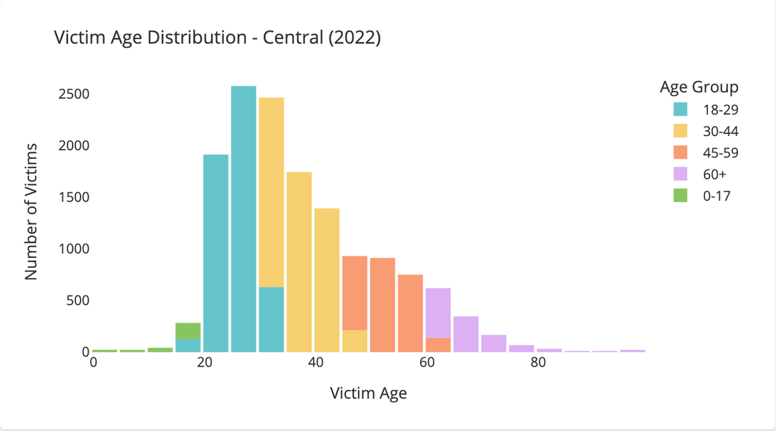
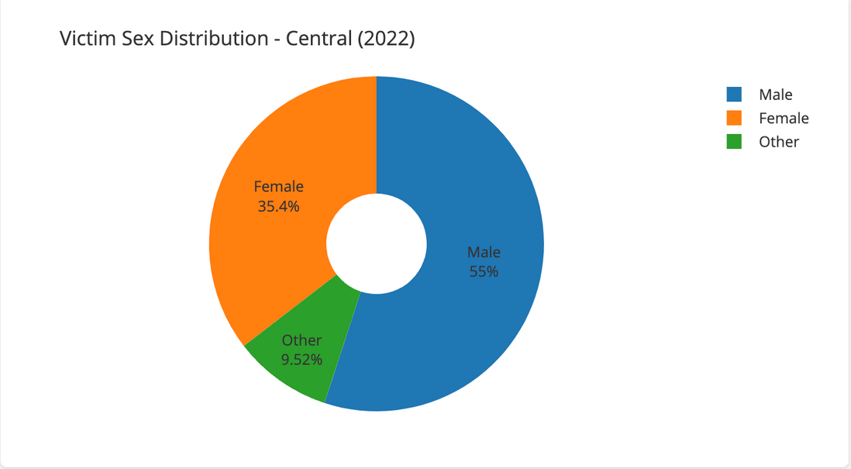
Demographic Analysis
Which sex/gender group is most impacted by crime in Central LA?
Young adults (18-29) are the most victimized group, accounting for 2600 cases followed closely by those aged 30-44.Victim numbers decline with age, but remain significant through all age brackets Males are more likely to be crime victims overall-likely due to assaults or street crimes. 35.4% Females share may be due to domestic violence . “Other” accounted for 10%, emphasizing the need for inclusive victim support systems.

Slide 15
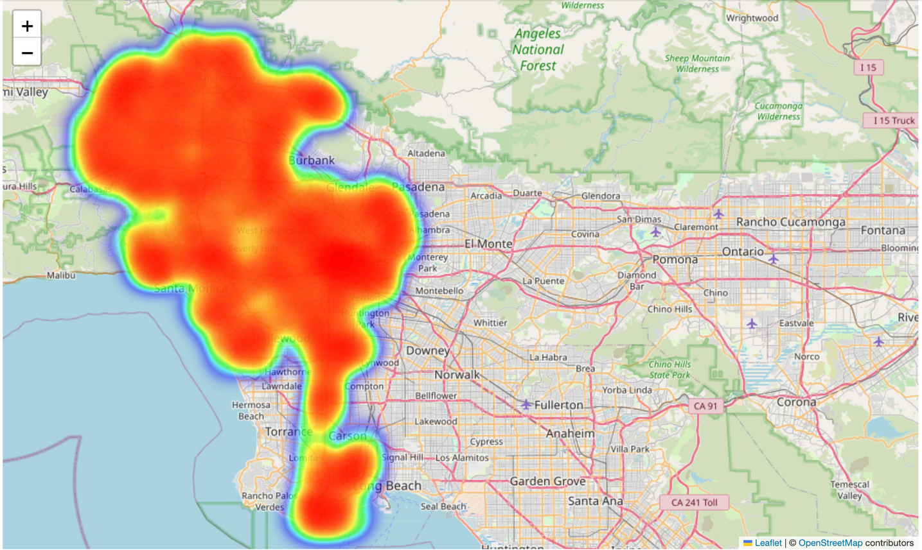
Spatial Analysis – Hotspot Mapping
Which areas in Los angeles have the highest crime density?
Key Insights & Recommendations
This is an additional metric that can help the police department allocate their resources more effectively.
We see that the crime rate is less on the borders of the city and crimes are more concentrated on the interior parts of the city.
Downtown LA, Hollywood, and South central are the most intense red zones. Santa Monica, Inglewood and parts of Long Beech also show strong crime presence. Surprisingly, Malibu and outer coastal suburbs show low crime density-mostly green zones. Areas like Pasadena,Burbank, and northeastern suburbs are much cooler on the heatmap.

Slide 16
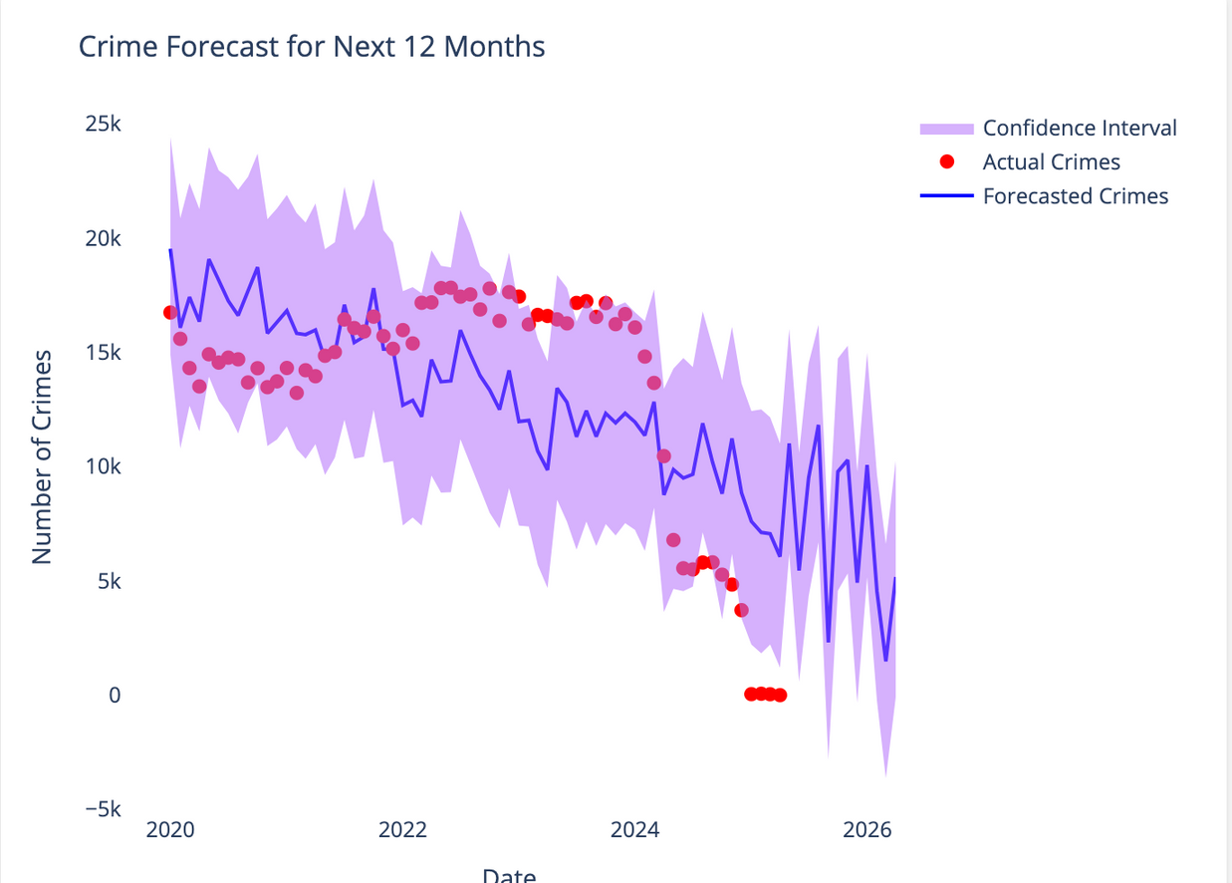
Predictive Modeling
Is crime expected to rise,fall, or stabilize over the next year?
Downward Crime Trend:
Strong indication of steady crime reduction,likely due to improved law enforcement strategies
Forecast Confidence Weekens over Time:
Indicates less certainty the farther the forecast goes-typically in time-series predictions
Absence of red dots in late 2024 syggests missing or delayed data.This may skew confidence in model calibration and needs resolution.

Slide 17

Conclusions
This crime data analysis uncovers key trends across time, geography, and victim demographics. High-crime zones were consistently identified, while seasonal and yearly variations in crime patterns were clearly observed. Victim profiles revealed age and gender-based vulnerabilities, and weapon usage insights added depth to crime type analysis.
Interactive dashboards enabled flexible filtering by year and location, and predictive modeling using Prophet offered valuable foresight into future crime trends. These insights support data-driven decisions for law enforcement, urban planning, and community safety strategies.

Slide 18



